Slide 1

B.Tech Project Evaluation-1 ANDROID APPLICATION
FOR IMPROVING AND EASING HUMAN’S LIFESTYLE
Presented by :-
DIVYANSH ARUN (180102006)
KARUN SAHANI(180102012)
ANSH GANGWAR(180102004)
SAMRAT BORAH(180102025)
Under the Supervision of:-
Ms.Gunjan Aggarwal
Sharda University, Gr. Noida
DEPARTMENT OF COMPUTER SCIENCE & ENGINEERING
SCHOOL OF ENGINEERING AND TECHNOLOGY
Feb 2022

Slide 2
Abstract
'Being a human' is an android application primarily focusing on the youth’s lifestyle, ‘Being a human’ application will help users in easing, improving and enhancing their lifestyle.This is an AI(Artificial Intelligence) based app. In this busy and hectic life we all need something to hold our details, to keep reminding us for our daily essentials and need. From health to relationship, this app is like your virtual personal manager, enhancing your lifestyle with a touch of artificial intelligence. The features of the application makes it an unique application as summing up the features it’s like an all in one application having features of more than ten applications into a single application.

Slide 3
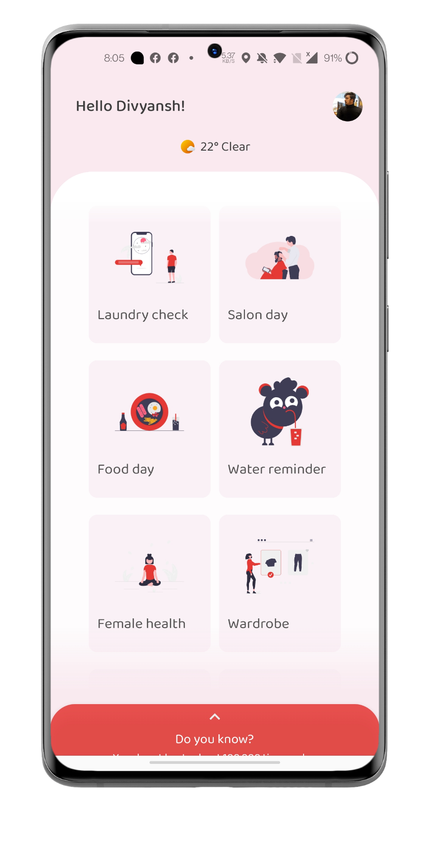
Project overview:
The application will take few information from the user at the time of sign up. After that the application will open the menu home screen.
The application is based on three main components which uses artificial intelligence and particular data set for individual feature.
Virtual wardrobe and outfit recommender is based on artificial intelligence as the application’s inbuilt camera scans for the color present in cloth along with the color code by which it makes decision in outfit recommender section. User can create multiple drawers and can add different outfits.
The features of the application makes it an unique application as summing up the features it’s like an all in one application having features of more than ten different applications.
Fig - Application's home screen

Slide 4
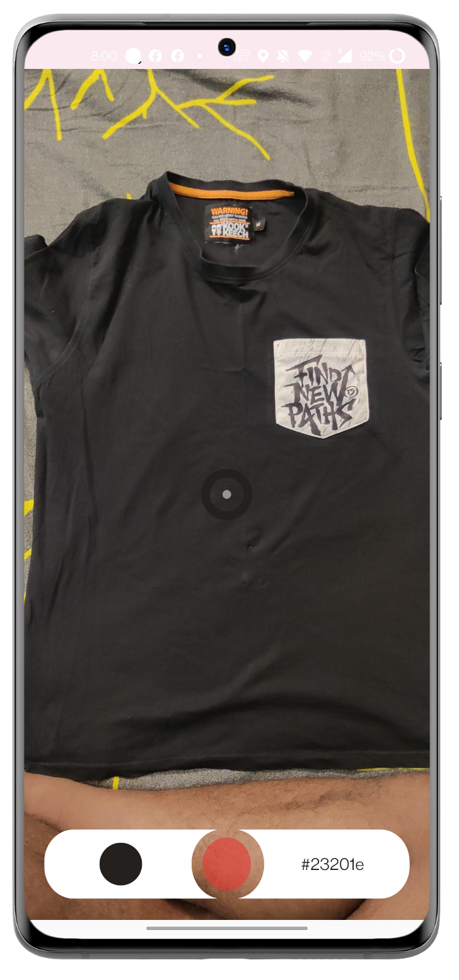
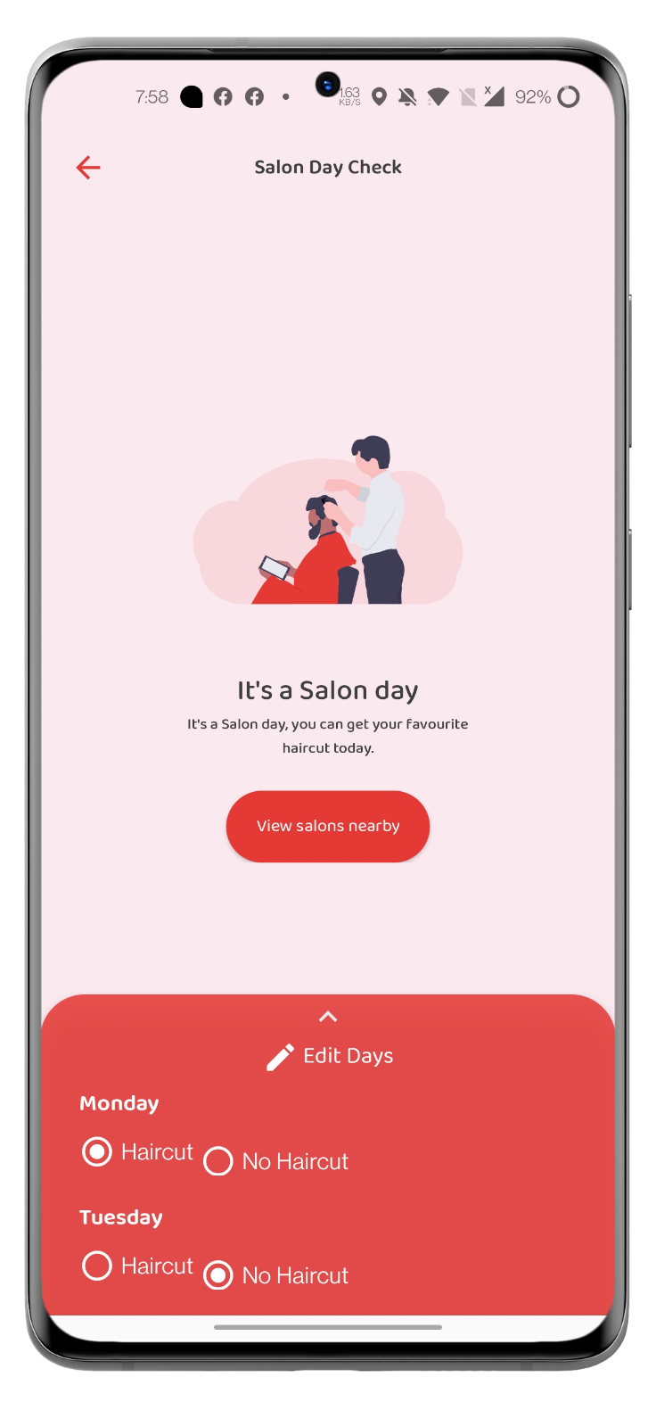
Project overview (cont.) :
Features of the application:
Laundry Checker
Virtual Wardrobe
Periods Tracker
Veg/Non Veg Day/Salon Day Alert
To-do list
Water Reminder
Task Reminder
Routine Organizer
Stay in touch with loved ones
Daily Facts
Fridge Manager
Expense Tracker
Fig - Real time color code scanning & salon day finder

Slide 5
Techniques Used :
1. Artificial Intelligence based real time hex code detection
2. Decision making by matching hex code with base colors
3. Weather & humidity based calculation & predictions
4. Female menstrual cycle analysis and estimations
5. Condition based decision making

Slide 6
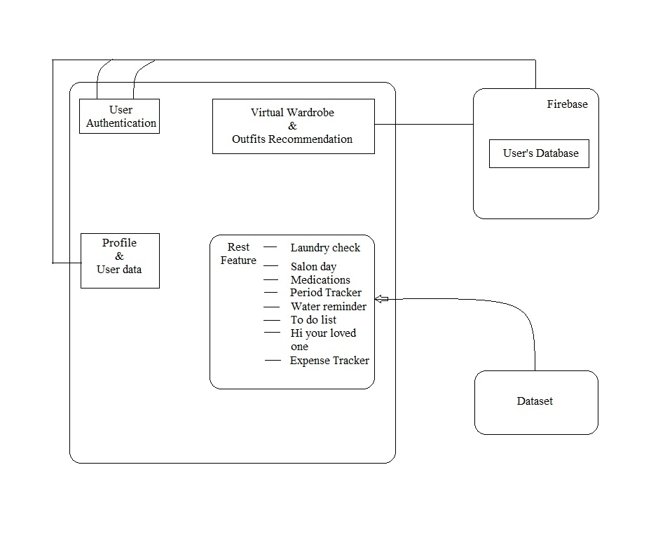
System Achitecture
Fig - System architecture
The application is based on three main components which uses artificial intelligence and particular data set for individual feature. Virtual wardrobe and outfit recommender is based on artificial intelligence as the application’s inbuilt camera scans for the color present in cloth along with the hex code by which it makes decision in outfit recommender section.

Slide 7
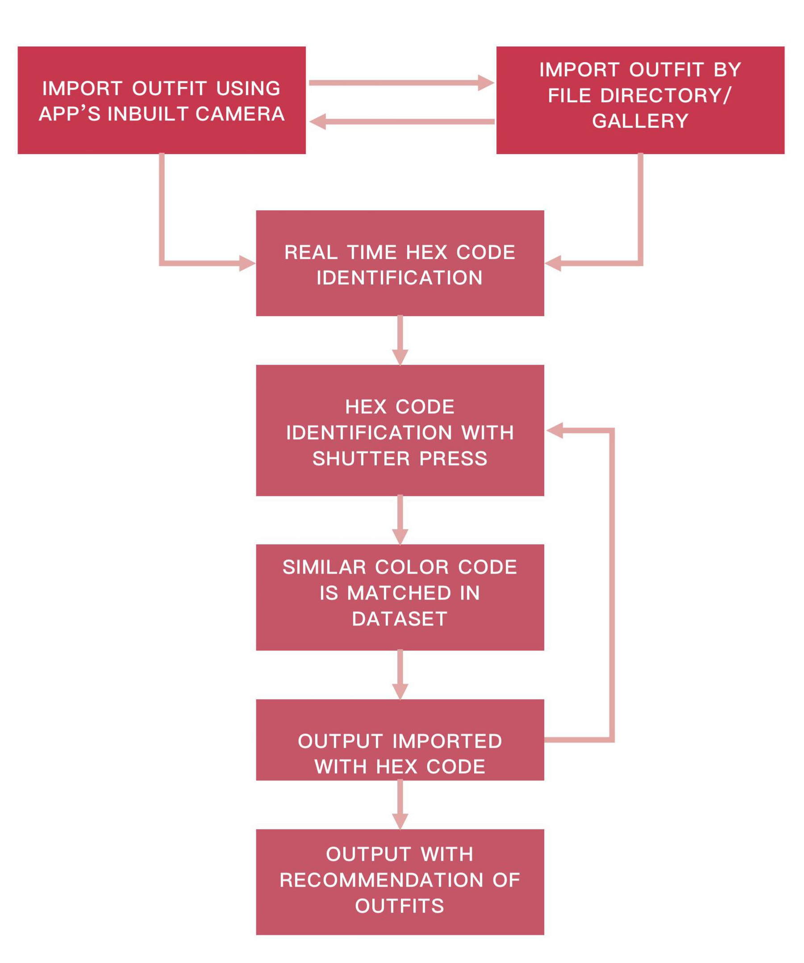
System Architecture (contd.)
Virtual Wardrobe is one of the main feature of this application and in the above activity diagram of virtual wardrobe the very first thing is importing the image of the clothes in proper lighting condition. Once the image is added, it needs to be categorized in any of the one category which are : Formal, Casual and Ethnic. Once the image is imported in the application, the major color used in the cloth is picked and the color is identified using the Artificial Intelligence. After that the base color data is stored in the application’s internal local database. Now according to the day wise data-set, the recommendation of the application is built which comes under the decision stage.

Slide 8
Workload distribution of the team
Divyansh Arun | Back end + Front end + Graphics + Debugging
Karun Sahani | Front end + Data Collection
Ansh Gangwar | Back end + Data Collection
Samrat Borah | Algorithms

Slide 9
Improvement/Work done from the last evaluation
We implemented the last feature of ‘whats in my fridge’ section into the application.
We submitted our research paper in total 5 conferences and it was accepted by the all of them .
But we proceeded with IEEE conference INCET 2022 and we submitted our camera ready paper recently.

Slide 10
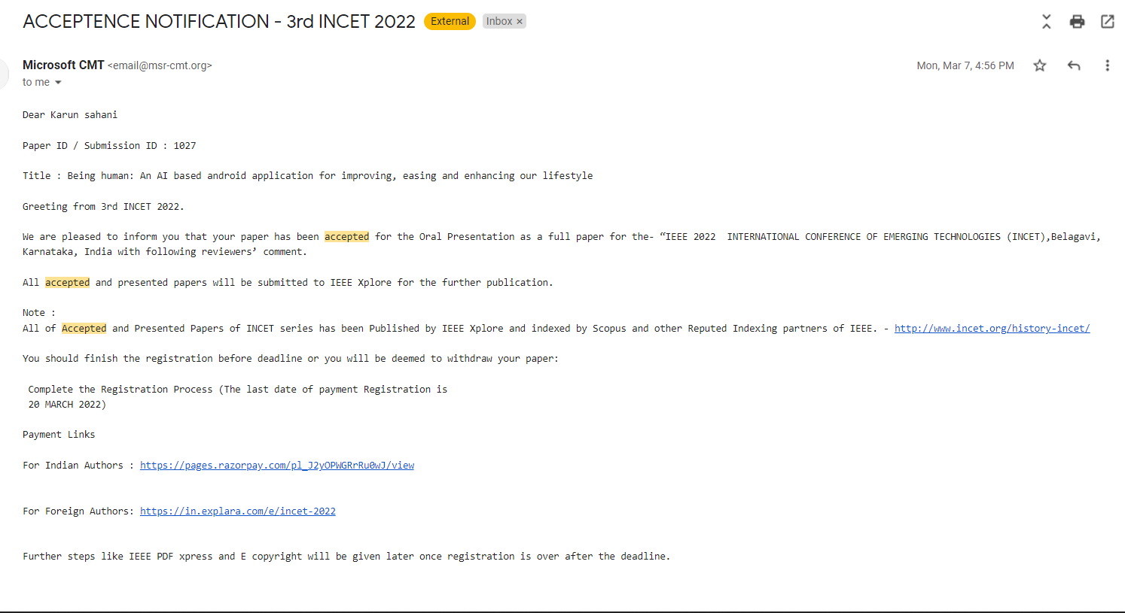
Proof of paper accepted

Slide 11
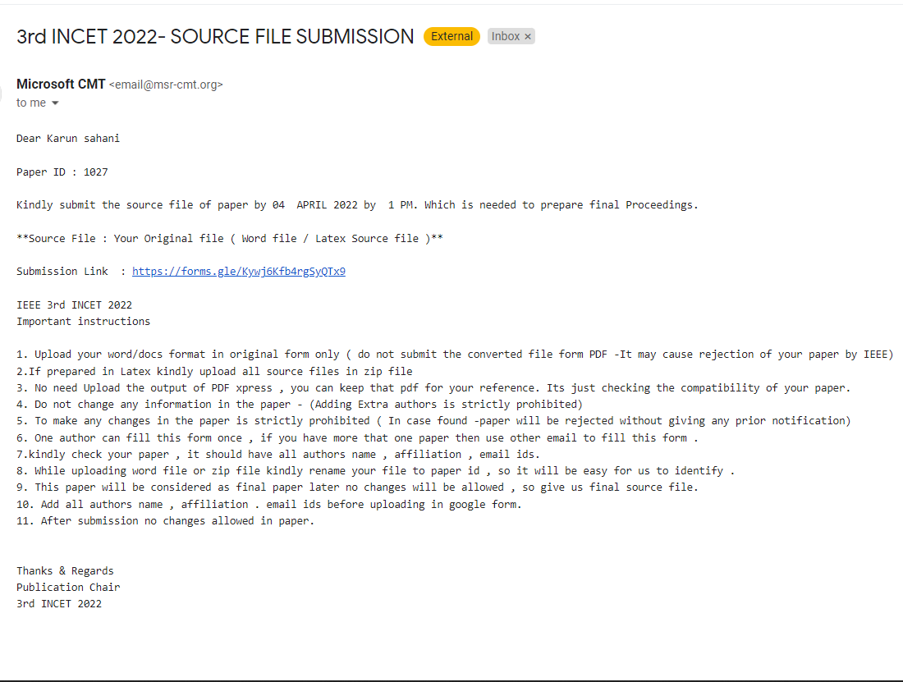

Slide 12
Result
‘Being a human’ is a complete application every individual should have as the application becomes your personal manager. The features of the application covers major lifestyle parts like assuring user’s water consumption, medicine routine, female menstrual cycle tracker, expense manager, virtual wardrobe, outfit recommender and fridge management. This application can really enhance, ease and improve human’s lifestyle. Users can rely on this application and these features can really make their life easy. Users can use outfit recommendation system of the app for finding their outfit of the day, they can easily browse their wardrobe on their phone virtually. To do list, routine organiser and expense tracker features can be used for keeping their data organized and also having their eye on their monthly expenses along with proper analytics. Female users can use period tracker feature of the app for tracking their menstrual cycle every month and also the app will send notification about days left in next period cycle and if it gets delayed. Water reminder feature aims to ensure water consumption of ‘being a human’ users, a floating notification will keep on reminding you for drinking a glass of water at regular intervals.

Slide 13
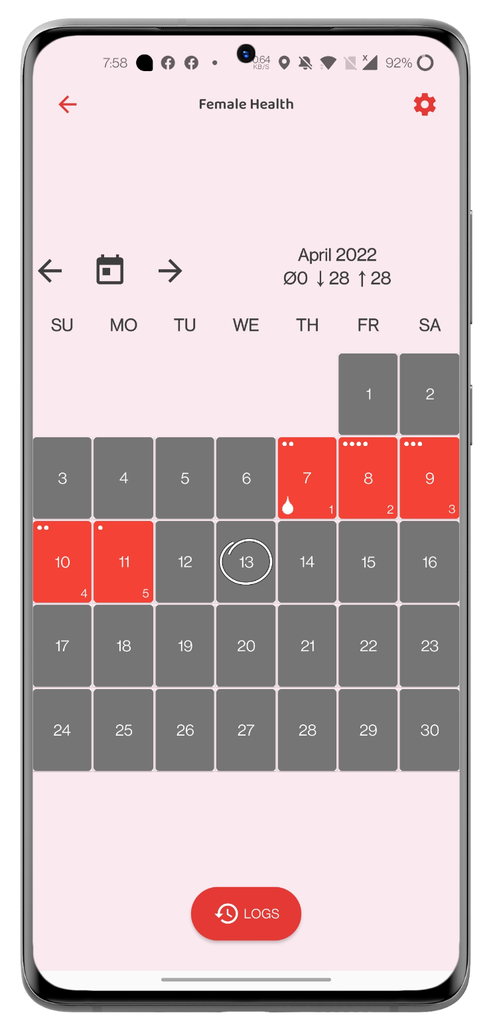
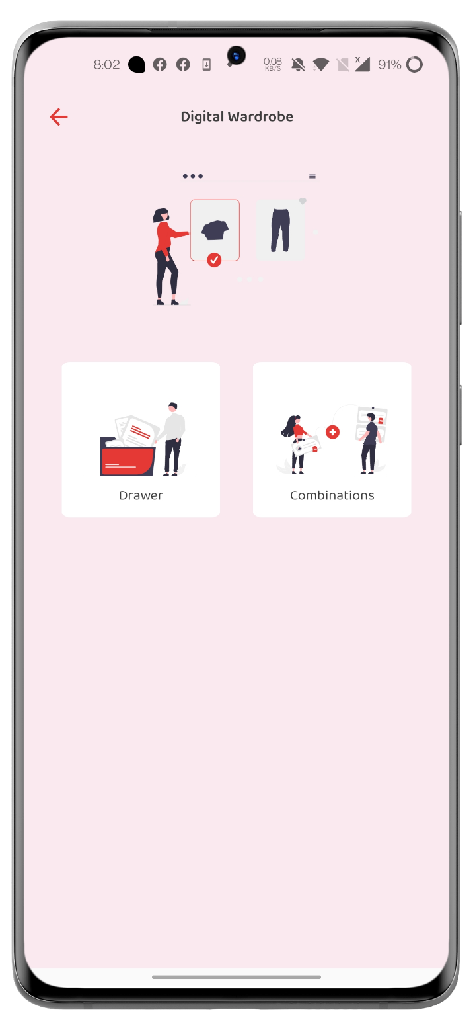
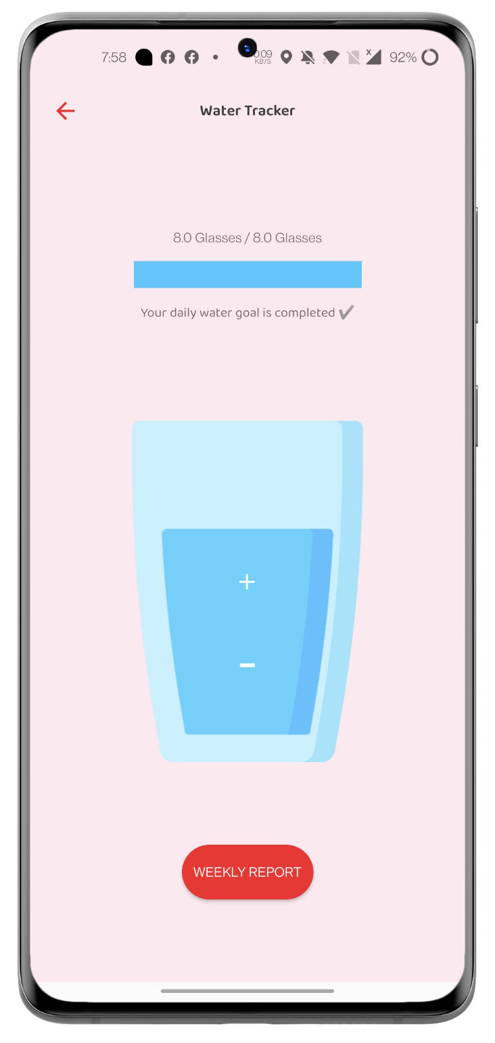
Output
Fig : Screenshot of application ( Period tracker, virtual wardrobe, water reminder )

Slide 14
Conclusion :
The application offers some unique features which aren’t existing right now in terms of apps. Some features like to do list, female periods tracker and expense manager exist but the user will have to download different apps for each purpose. This application sort this problem out as it will include all the features in just one application. Also overall this application will be like a personal manager for every individual user as it will keep personal records and data of the user and the user can easily rely on the application. With time and in app surveys we will add more features in the application which will focus on improving, easing and enhancing user’s lifestyle.

